Slide 1
Final Project:
College Basketball Data
By: Anna Brown, Annie Edmonds, John Jordan, James Kulp, and Emory Wise

Slide 2
Data Selection
Objective: Analyze the effect of new transfer portal rules on regular season and postseason success for each conference in the NCAA.
Two datasets from Kaggle
2019 NCAA Basketball Stats
2022 NCAA Basketball Stats
Key Variables:
CONF: The Athletic Conference in which the school participates in
(A10 = Atlantic 10, ACC = Atlantic Coast)
W: number of games won
G: number of games played
ADJ_T: Adjusted Tempo
Estimate of possessions per 40 minutes
POSTSEASON: How far a team made it into the Playoffs
E8 = Elite 8, F4 = Final Four, etc.
ADJOE and ADJDE: Adjusted Offensive Efficiency and Adjusted Defensive Efficiency
Estimated points scored or allowed per 100 possessions
Notes:
James
Chose 2022, because 2021 and 2020 may have been affected by COVID.

Slide 3
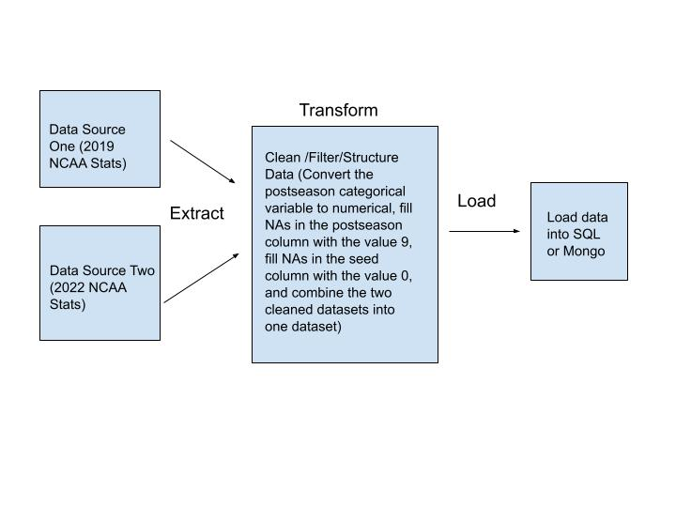
ETL Process
Extract Data:
2019 NCAA Basketball Stats
2022 NCAA Basketball Stats
Transform:
Create dictionary to map the categorical values to new numerical values
Create function to fill NAs of a column with new values
NAs in postseason column→ value 9 (team did not make tournament)
NAs in seed column → value 0 (team did not make tournament)
Combine the two cleaned datasets into one dataset
Load:
Choose desired data source (2019 stats, 2022 stats, or merged dataset)
Choose desired format (SQL or Mongo)
Notes:
Anna
Based on our objective, we developed an efficient ETL pipeline for longitudinal analysis. First, we extracted our two datasets from a github. Next, during the transformation stage, we cleaned the data by mapping categorical variables into numerical values. For example, the POSTSEASON variable was mapped from 1 for the winner to 9 for teams with no postseason, and the SEED variable assigned 0 to teams that didn’t make the tournament.We also wrote a function to handle missing data, filling NAs in specific columns with appropriate values. Once the data was cleaned, we merged the datasets to set things up for our analysis. Finally, we loaded the transformed data into either SQL or MongoDB, depending on user preference. This pipeline gives us a reliable and repeatable way to integrate and analyze historical and performance data.

Slide 4
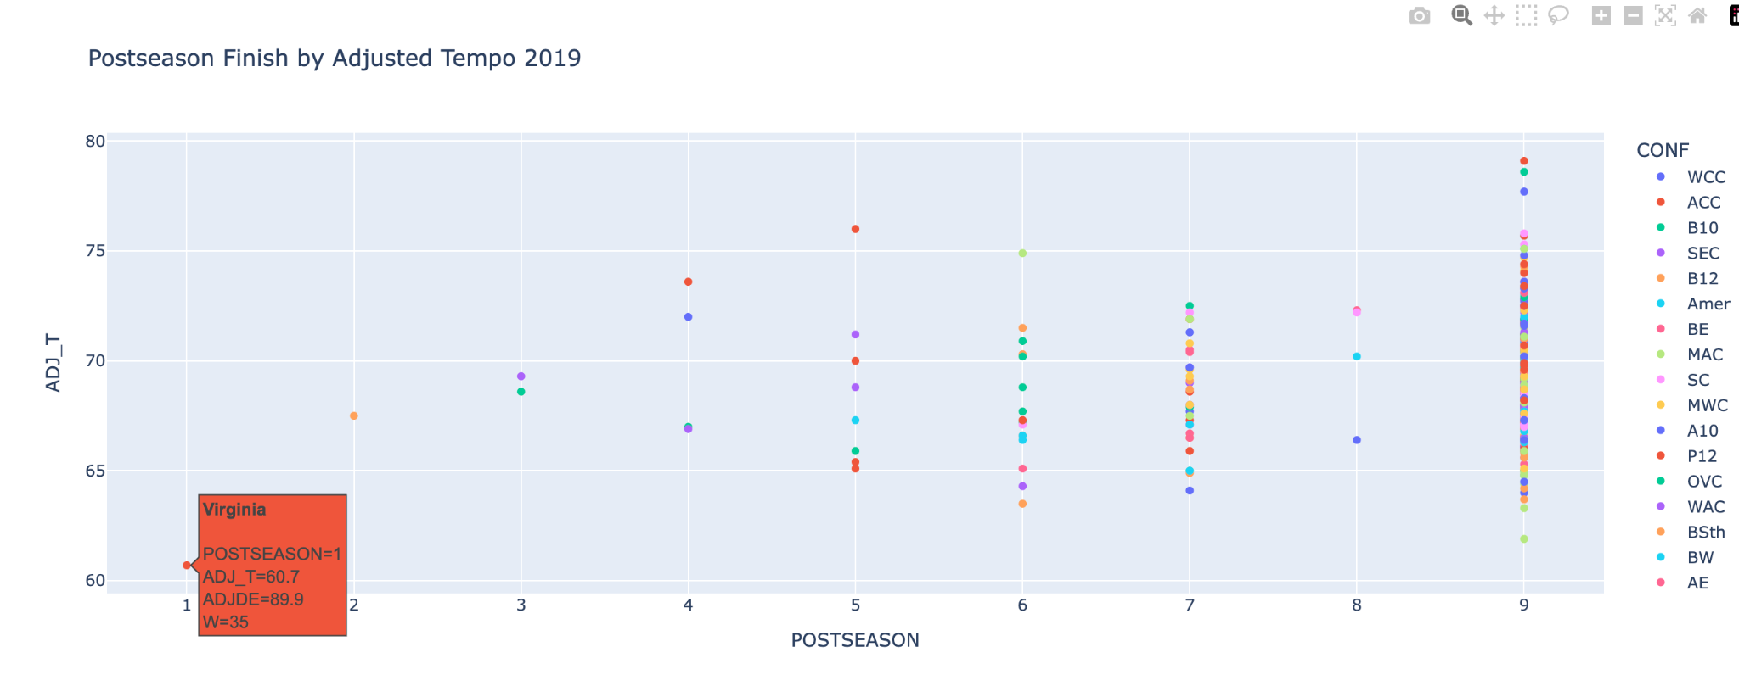
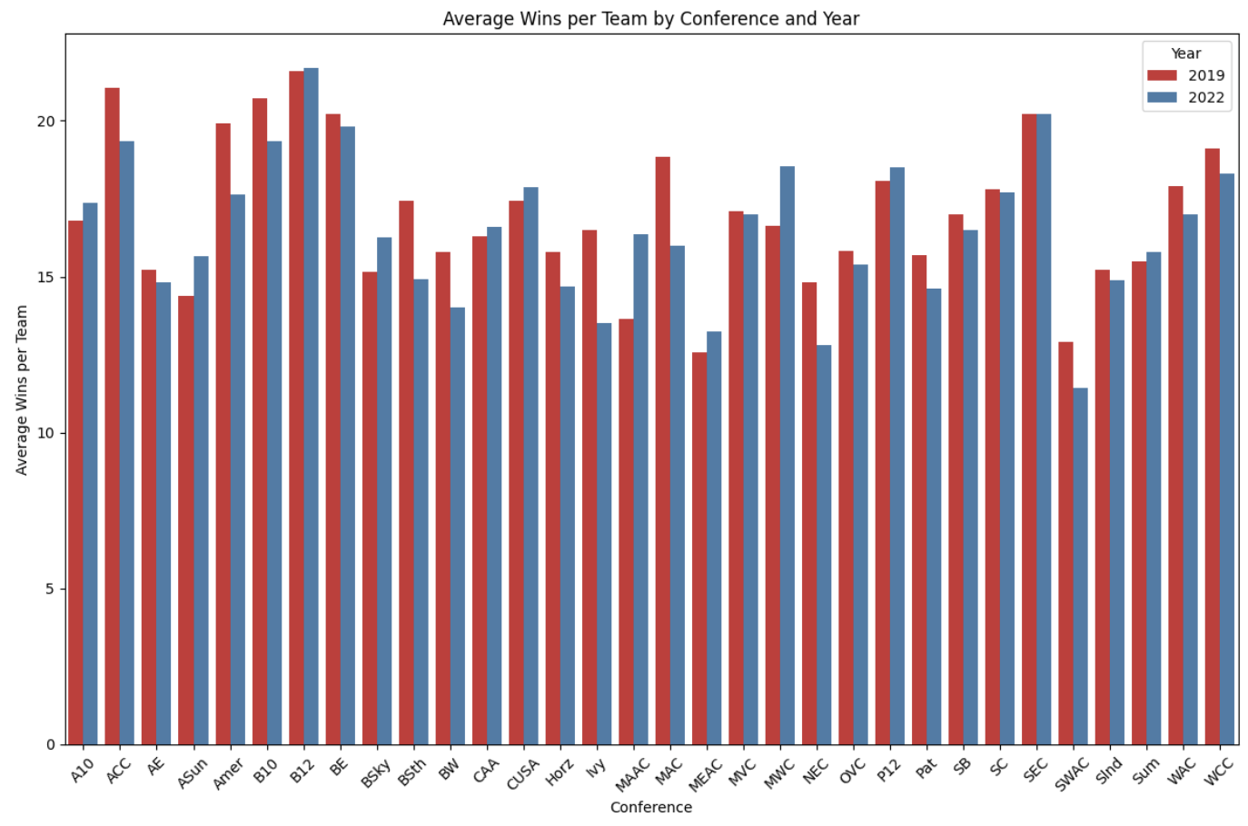
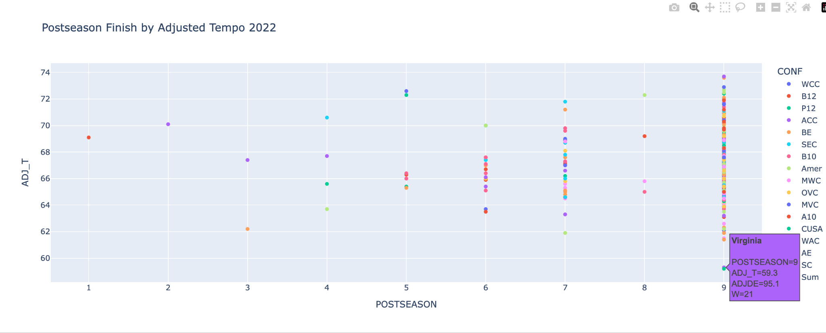
Data Analysis
Notes:
Emory
Avg number of wins drops from 16.97 wins to 16.49 (-0.48) → We wanted to compare the two years to investigate the impact of the transfer portal on conferences as a whole
In 2022, teams with higher Adjusted tempos did better than those with lower adjusted tempos, especially compared to 2019. This may be attributed to the fact that high level portal players want to go to teams with higher tempos because this will better showcase their scoring ability and thus potentially boost their NBA draft stock.

Slide 5
Google Cloud Storage
Create/Configure Bucket
Bucket name: college-basketball-insights
Region: US (multiple regions in United States)
Storage class: Standard (frequently accessed data)
Access control: Fine-grained (for better security)
File Structure
Processed dataset/combined 2019 and 2022 NCAA basketball stats
'transformed_data/cbb_19_and_22.csv'
Security
Create service account: google-cloud-storage-upload@final-project-442418.iam.gserviceaccount.com
Create key
Edit permissions
Added team members as owners
Notes:
Annie
Our last step was to create the Google Cloud Storage bucket to store the processed datasets
Some of the key configurations include: bucket name; we chose the region to be the US to ensure high availability for team and data users in the US; Storage class: standard storage class which is optimal for frequently accessed data: set the access control to fine-grained for better security
File Structure: wanted to organize our data within the bucket. The file contains combined and processed basketball statistics from 2019 and 2022
Security Measures: security account creation manages interactions with the bucket and limits access; the key is generated for authentication and ensures that only authorized users can change the data; permission management: edited to add the team members as owners to give them full control/access to the data

Slide 6
Challenges and Key Insights
Challenges
Google Cloud Storage Set-up
Constructing/managing Google Cloud storage buckets
“Export” section of ETL pipeline
Developing a pipeline that could export cleaned data to either Mongo or SQL based on user preference
Key Insights
More parity across conferences
More success for teams that play at a higher tempo
Overall, we found that the Transfer Portal had little impact in its early years; however, we anticipate that future years will demonstrate a more significant effect of the portal as teams and players better understand how to use it
Notes:
John
Parity across conferences: demonstrated by the drop in average wins by conference (better conferences dropped a little bit in avg wins per team, and mid majors got a little better) (ACC and Big10 worse, ASUN and MVC got better)
As Emory said, teams that play at higher tempos likely attract better portal recruits and thus have better success, especially in the postseason as demonstrated by the success of high tempo teams in the visualization of the 2022 postseason

Slide 7
Questions?

